Slide 1
Course 1 PROMOTING GOVERNANCE: THE CORPORATE GATEKEEPER'S ROLE Sponsored by Packt Pubilshing Ltd 2022 Presented By Dr. Zabihollah (Zabi) Rezaee

Slide 2
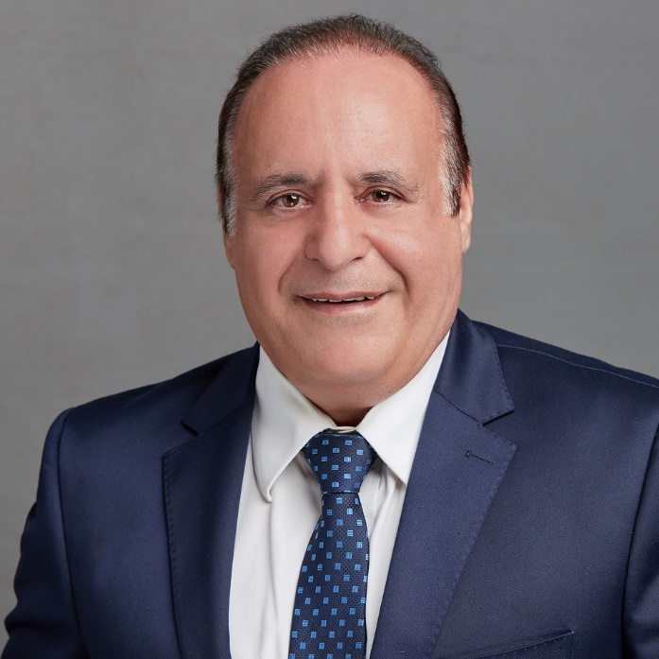
Welcome to ACCT 7050 BUSINESS SUSTAINABILITY, CORPORATE GOVERNANCE, AND ORGANIZATIONAL ETHICS
By Zabihollah (Zabi) Rezaee
PhD, CPA, CMA, CIA, CFE, CGFM, CSOXP, CGOVP, CGRCP, CGMA, CRMA
Thompson-Hill Chair of Excellence
& Professor of Accountancy
Crews School of Accountancy
Fogelman College of Business and Economics
The University of Memphis
Spring 2021

Slide 3
A Little About Your Instructor
PhD in Accounting
Thompson-Hill Chair of Excellence
10 certifications – CPA, CFE, CMA, CIA, CGFM, CSOXP, CGRCP, CGOVP, CGMA, CRMA
250 articles
300 presentations
11 book chapters
More than 35 years of teaching and practical experiences
Served on the Standing Advisory Group of the PCAOB, 2004-2006
12 books
Editor of the Journal of Forensic Accounting Research (JFAR) of the AAA
Business Sustainability, Corporate Governance, and Organizational Ethics
https://books.google.com/books/about/Business_Sustainability_Corporate_Govern.html?id=LDr8wgEACAAJ
Website
https://www.memphis.edu/accountancy/faculty/zrezaee.php
Email: zrezaee@memphis.edu
Phone: 901-678-4652

Slide 4

Corporate Governance Post-Sarbanes-Oxley: Regulations, Requirements, and Integrated Processes
Lynn Turner writes, “Corporate Governance Post-Sarbanes-Oxley appropriately provides the reader with a useful discussion of emerging and contemporary issues confronting those involved with corporate governance including those in the monitoring function, as well as those in the growing field of not-for-profit organizations. And it adds an international flavor to its pages, which is unquestionably important and useful as today’s largest investors as well as accomplished management teams and directors come from a multitude of countries.”
Michael McCauley, Director of Corporate Governance for the Florida State Board of Administration, wrote, “Corporate Governance Post-Sarbanes-Oxley offers one of the most comprehensive examinations available. Dr. Rezaee achieves an in-depth, thorough review of today’s corporate governance landscape and provides a sound perspective for the reader. His systematic description offers a practical guide for any investor interested in the role of governance within the capital markets. An excellent book.”
by Zabihollah Rezaee, published by John Wiley & Sons, 2007

Slide 5
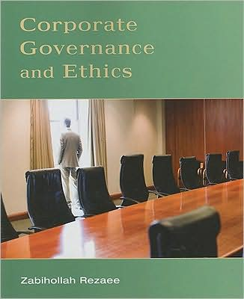
Corporate Governance and Ethics by Zabihollah Rezaee Published by Wiley, July 2008

Slide 6
Audit Committee Book Zabihollah Rezaee Business Expert Press July 2016
Audit Committee Formation in the Aftermath of the 2007–2009 Global Financial Crisis, Volume I
Structure and Roles
Audit Committee Formation in the Aftermath of the 2007–2009 Global Financial Crisis, Volume II
Responsibilities and Sustainability
Audit Committee Formation in the Aftermath of the 2007–2009 Global Financial Crisis, Volume III
Emerging Issues

Slide 7
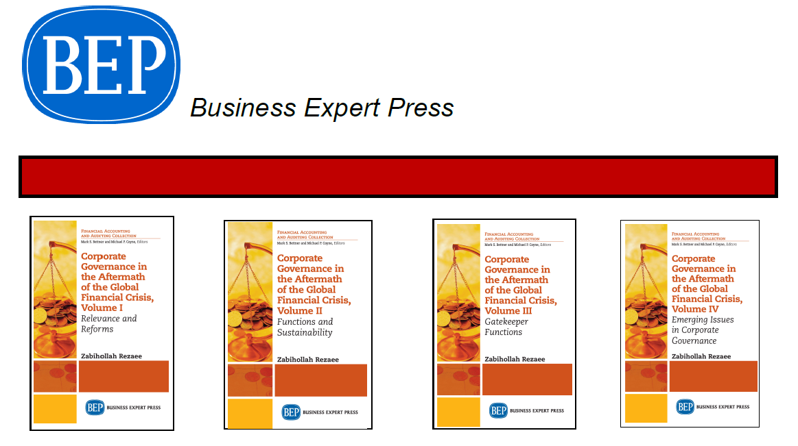
Notes:
This book is organized into four separate volumes; each volume can be utilized separately or in an integrated
form.

Slide 8

Business Textbook
30 chapters organized into four modules on Business Sustainability, Corporate Governance and Organizational Ethics.
•Addresses the latest revisions to the AACSB Accreditation Standards.

Slide 9
DEFINITION OF CORPORATE GOVERNANCE
SEGMENT: 1

Slide 10
Definition
Agency Theory
Legal Compliance
Corporate Strategy
Scholarly Research

Slide 11
Corporate Governance vs Stakeholder Governance
Corporate Governance determines power-sharing between shareholders, the board of directors and management.
Stakeholder governance is a process of managing and running a corporation to serve interests of all stakeholders including shareholders, employees, suppliers, customers, communities, society, and the environment
Stakeholder governance is a better solution to corporate accountability, economic performance, and prosperity in response to the COVID-19 pandemic.
Proponents support that stakeholder capitalism and stakeholder governance intends to benefit all stakeholders.
Opponents argue that stakeholder governance does not benefit stakeholders while imposes additional costs on shareholders and society.
the World Economic Forum (WEF, 2020a) supports the concept of stakeholder governance in the context of stakeholder capitalism and has developed the stakeholder governance principles to protect interests of all stakeholders.

Slide 12
Corporate Structure
Corporation
Create
Owners
Accountants
Elect
Management
Board of
Directors
Hires
Hires
Audit Committee
Prepares
Internal
Auditors
Hires
Independent
Auditors
Examine
(GAAS)
Financial Statements (GAAP)

Slide 13
Reasons For Business Failures
Ineffective Corporate Governance
Insufficient Understanding of Financial Reports
Lack of Effective, Efficient, Scalable, and Enforceable Regulations, Standards, Rules, and Procedures
Irresponsible Corporate Gatekeepers
Lack of Board And Executive Effectiveness
Boards and Executives Risk Blindness
Poor Leadership; Tone at the Top
Defective Communication
Inappropriate Executive Compensation Schemes
Compromising Ethical Values and Professional Ethics
Corrupted and Unethical Corporate Culture

Slide 14
Corporate Governance Structure
Three Components:

Slide 15
Principles of corporate governance
SEGMENT: 2

Slide 16
Corporate Governance Principles
Honesty
Resilience
Responsiveness
Transparency
Value-adding Philosophy
Independence
Ethical Conduct
Accountability

Slide 17
Guiding Principles of Good Governance (GPGG) The Global Network of Director Institutes (GNDI), May 2015
Principle 1: Responsibility
Principle 2: Organizational culture
Principle 3: Disclosure of practices
Principle 4: Independence
Principle 5: Composition and leadership
Principle 6: Nomination
Principle 7: Knowledge

Slide 18
Guiding Principles of Good Governance (GPGG) The Global Network of Director Institutes (GNDI), May 2015
Principle 8: Risk
Principle 9: Relationship with management
Principle 10: CEO and senior executives
Principle 11: Communication
Principle 12: Evaluation
Principle 13: Remuneration
Principle 14: Add value

Slide 19
New Paradigm for Corporate Governance
Lead with the strategy
Confirm board involvement in the strategy
Make the case for long-term investments
Describe capital allocation priorities
Explain why the right mix of directors is in the boardroom
Address sustainability, citizenship and ESG/CSR
Articulate the link between compensation design and corporate strategy
Discuss how board practices and board culture support independent oversight

Slide 20
corporate governance measures
SEGMENT: 3

Slide 21
Corporate Governance Mechanisms
The corporate governance structure is shaped by:
Internal corporate governance measures
External governance measures

Slide 22
Internal Governance Mechanisms/Measures
Board of directors
Independent directors
Audit committee
Compensation committee
Nomination committee
Management
Internal controls
Internal audit functions

Slide 23
External Mechanisms
Market for corporate control
Capital market
Labor market
Federal and state statutes
Court decisions
Shareholders’ proposals
Best practices of investors’ activists

Slide 24
Sources of Corporate Governance Measures
Corporate Laws | May vary from state to state, but most have adopted Model Business Corporation Act
The Federal Securities Laws | The Securities Act of 1933 and the Securities Exchange Act of 1934, Sarbanes-Oxley (SOX) Act of 2002, Dodd-frank Act of 2010, JOBS Act of 2012
Listing Standards | Adopted by national stock exchanges
Best Practices | Recommended by professional organizations (e.g. The Conference Board, the Business Roundtable Institute. Council of Institutional Investors), Europe Corporate Governance

Slide 25
SOX Purposes
Establish an independent regulatory structure for the accounting profession
Set high standards and new guiding principles for corporate governance
Improve the quality and transparency of financial reporting
Improve the objectivity and credibility of audit functions
Empower the audit committee
Create more severe civil and criminal remedies for violations of federal securities laws
Increase the independence of securities analysts

Slide 26
Summary of the Provisions of SOX
1. Mandatory formation of the audit committee
2. Enhanced audit committee responsibility for hiring, firing, compensating, and overseeing auditors and preapproval of non-audit services
3. Disclosure of audit committee “financial expert”
4. Executives (CEOs and CFOs) certification of the accuracy and completeness of quarterly and annual reports
5. Management assessment and reporting of the effectiveness of disclosure controls and procedures

Slide 27
Summary of the Provisions of SOX (cont.)
6. Ban on personal loans by companies to their directors or executives other than certain regular consumer loans
7. Establishment of procedures by each audit committee for receiving, retaining, and handling complaints received by the company concerning accounting, internal controls, or auditing matters
8. Forfeiture by CEO or CFO of certain bonuses and profits when the company restates its financial statements
9. Improper influence on conduct of audits
10. Officers and directors’ bars and penalties for violations of securities’ laws or misconduct

Slide 28
Summary of the Financial Reporting Provisions of SOX
:
1. CEO/CFO certification of financial reports
2. Internal control report by management
3. Attestation and report by auditors on management’s assessment of internal controls
4. Disclosures of off–balance sheet arrangements
5. Disclosures of contractual obligations
6. Disclosures of reconciliation of non-GAAP financial measures pertaining to pro forma financial information
7. Disclosures of material correcting adjustments by auditors

Slide 29
Summary of the Audit Provisions of SOX
Establishment of the Public Company Accounting Oversight Board (PCAOB)
2. Registration with the PCAOB of public accounting firms that audit public companies
3. Requirement that auditors be appointed, compensated, and overseen by the audit committee
4. Many non-audit services are prohibited from being performed contemporaneously with an audit
5. Rotation of the lead (or coordinating) audit partner and the lead review partner every five years

Slide 30
Summary of the Provisions of SOX (cont.)
6. Auditors’ attestation to and reporting on management assessment of internal controls
7. Limitations on partner compensation
8. Disclosure of fees paid to the auditor
9. Requirements for preapproval of audit and permitted non audit services by the audit committee
10. Retention of audit work papers and documents for five years
11. Increased penalties for destruction of corporate audit records

Slide 31
Dodd-Frank Act of 2010: Financial Reform Act
Its provisions pertain to banks, hedge funds, credit rating agencies, and the derivatives market
Increases capital requirements
Regulates OTC derivatives
Establishes governance and compensation measures
Does not address Freddie Mac and Fannie Mae or Too-Big-To-Fail (TBTF)
Authorizes the establishment of an oversight council to monitor systemic risk of financial institutions
Creation of a consumer protection bureau within the Federal Reserve

Slide 32
The Dodd-Frank Act Other Areas of Regulatory Reform
Executive Compensation
Say on pay
Independent Compensation Committees
Investor Protections
“Skin in the game”
Credit Rating Agencies
Creates Office of Credit Ratings at SEC
Claw backs
New Disclosures
Shareholder proxy access
Broker-dealer study on fiduciary duties and new disclosures
Whistle blowing
Municipal securities
Annual assessment of SEC internal supervisory controls
Investors permitted to bring private rights of action for knowing or reckless failure to conduct a reasonable investigation
Rating methodology, use of third parties for due diligence, and ratings track record

Slide 33
Jumpstart Our Business Startups Act (JOBS) Act of 2012
Enables emerging growth companies (EGCs) to go public without being subject to full vigorous range of regulations
May loosen investor protections in favor of creating more jobs
Allowing broker-dealers to issue research reports on EGCs before, during, or after IPOs
Permitting research analysts to communicate with investors and management in connection with the IPO of an EGC

Slide 34
Concerns of JOBS Act of 2012
Relaxation of IPO requirements may be detrimental to investors and the capital markets by:
Reducing transparency and investor protection
Making securities law enforcement more difficult
Reducing publicly available information by exempting EGCs from currently mandated certain disclosure and other requirements

Slide 35
corporate governance functions
SEGMENT: 4

Slide 36
CORPORATE GOVERNANCE FUNCTION
OVERSIGHT
MANAGERIAL
Board of Directors
Audit Committee
MONITORING
Management
Stakeholders
Public Trust and Investor Confidence
COMPLIANCE
Governing Bodies
Corporate Governance Effectiveness
EXTERNAL AUDIT
External Auditors
INTERNAL AUDIT
ADVISORY
Internal
Auditors
Legal Counsel Financial
Analysts

Slide 37
Board of Directors
Pre-SOX Framework
Personal ties to company management
Economic ties to the corporation (consulting fees, generous ownership pensions)
Improve their working relationships with management
Post-SOX Framework
The majority of directors should be independent
Separate the roles of chairman of the board and CEO
Develop the knowledge and expertise to provide effective board oversight
Have resources to hire advisors and independent staff support
Set a “tone at the top” and a corporate culture that promotes ethical conduct
Periodic evaluation of the performance of the board of directors

Slide 38
What Are The Board’s Main Responsibilities?
Monitor company performance
Set corporate strategy
Oversee/approve capital budget and key operating budgets
Set/approve compensation for top executives
Oversee risk management
Evaluate top executive performance
Oversee corporate reporting and disclosures
Communicate with all stakeholders

Slide 39
What Are The Board’s Main Responsibilities? (cont.)
Succession planning
Board Effectiveness
Director recruitment and succession
Executive talent management and leadership development

Slide 40
Board Characteristics
Board leadership
CEO Duality
Lead Director
Board Authority
Board Composition
Responsibility
Board Independence
Directors’ Compensation

Slide 41
Board Accountability
Accountability to Shareholders
Accountability for Board Operation
Accountability for Strategic Decisions and Performance
Accountability to Stakeholders
Accountability under Business Sustainability

Slide 42
Effective Board of Directors
Create an open and engaging boardroom atmosphere
Maximize the value of the board’s time commitment
Determine the information the board needs
Dedicate time to strategic issues
Create a transparent, explicit, and accountable executive pay process

Slide 43
Effective Board of Directors (cont.)
Actively engage in the CEO succession process
Assess the strength of the company’s management talent
Monitor the company’s enterprise risk management system
Oversee the reliability, quality, and integrity of the financial and control processes

Slide 44
board committees
SEGMENT: 5

Slide 45
Board Committees
Audit committee
Compensation committee
Governance committee
Nominating committee
Disclosure committee
Ethics and compliance committee
Other standing or special committees

Slide 46
Audit Committees
Pre-SOX
Voluntary audit committees
Personal and economic ties
Liaison between management and independent auditors
Limited knowledge of financial reporting
Infrequent and short meetings
Lack of proper authority and resources
Post-SOX
Mandatory audit committees
Independent members of audit committees
Financial expertise
Appoint, compensate, retain, and oversee independent auditor
Comply with new requirements for “independent” directors
Establish procedures for receipt, retention, and treatment of complaints relating to accounting, auditing, and internal control matters
Have authority to engage advisors
Be given appropriate funding, as determined by the audit committee, for external auditors and advisors
Disclosure of existence of at least one audit committee financial expert

Slide 47
Audit Committee Responsibilities
Corporate governance
Internal controls
Financial reporting
Audit activities
Code of ethics conduct
Whistleblower program
Enterprise risk management
Financial statement fraud

Slide 48
Compensation Committee
Structure
Responsibilities:
Evaluation of directors
Design and implementation of director compensation plans
Evaluation of senior executives
Design and implementation of executive compensation plans
Proxy statement disclosure

Slide 49
Nominating Committee
Structure
Responsibilities:
1. Reviewing the performance of current directors
2. Assessing the need for new directors
3. Identifying and evaluating the skills, background, diversity, and knowledge of candidates
4. Having an objective nominating process for qualified candidates
5. Assisting in the election of qualified new directors

Slide 50
challenges in corporate governance
SEGMENT: 6

Slide 51
Emerging Challenges in Corporate Governance
Director accountability and liability
The separation of chair and CEO roles
Executive compensation/say on pay
Board diversity
Compliance with regulatory reforms
Risk assessment and management
Corporate disclosures on KPIs
Succession planning
Communication with shareholders

Slide 52
Executives (CEO, CFO) Challenges
Inconsistency
Disrespect
Indecision
Arrogance
Greed
Non-communication
Assumptions
Accountability
Transparency
Compensation

Slide 53
ethics
SEGMENT: 7

Slide 54
Implementing an Effective Corporate Ethics Policy
Code of ethics
Communication and awareness
Training and reinforcement
Supporting context and culture
Monitoring and accountability
The litmus test

Slide 55
Whistle-Blowing Program
Must establish/enforce whistleblower program per Sarbanes-Oxley Act of 2002 (SOX) and Dodd-Frank Act of 2010 (DOF)
SOX –
confidential and anonymous submissions
DOF –
protection and rewards

Slide 56
SEC Whistleblower Rules
Eligible for awards when:
Information voluntary (not under subpoena)
Information original and not public
Information leads to enforcement of action
Whistleblower complied with procedures
Information true and correct

Slide 57
Best Practices of Whistle Blowing Programs
Establish effective internal program
Create tone at the top to come forward
Communicate with employees
Educate managers about anti-retaliation

Slide 58
Convergence in corporate governance
SEGMENT: 8

Slide 59
Convergence in Corporate Governance
The majority of directors must be independent, nonexecutive directors
Members of the audit, compensation, and nomination committees must be independent
Nonexecutive, independent directors do not receive compensation or fees other than their director fees
The audit committee, composed of truly independent directors, oversees financial reporting, internal controls, and audit activities
The audit committee is directly responsible for the appointment, retention, and compensation of the external auditor
Internal control reporting
Public Oversight Board

Slide 60
Differences?
Legal Infrastructure
Regulatory Environment
Information Infrastructure
Market Infrastructure

Slide 61
UK Corporate Governance vs. U.S. Corporate Governance
Board U.S.: board’s oversight function separated from management managerial function | Board U.K.: board ,on the contrary, is responsible for the preparation of financial statements and internal controls.
CEO: can assume position as a chairman of the board | CEO: cannot assume the position as a chairman of the board
Approach: less flexible approach Director Election: Plurality | Approach: more principle based, which requires companies to “comply or explain why not” Director Election: Majority

Slide 62
Comparison of Functions of the Traditional Corporate Governance and the New Stakeholder Governance (pre-and post-COVID-19 Pandemic)
Functions | Traditional Corporate Governance Functions (Pre-Pandemic) | New Stakeholder Governance Functions (Post-Pandemic
Oversight | Representative of shareholders to protect their interests. Shareholder-primacy focus. Oversight of the organization affairs in creating shareholder value. Pursue the mission of profit maximization and shareholder wealth creation. Strategy-driven oversight activities. Primary focus on the achievement of financial performance. | Representative of all stakeholders in protecting shared value. Stakeholder-primacy focus Oversight of the organization affairs in creating shared value for all stakeholders. Pursue the mission of profit-with-purpose in creating shared value for all stakeholders. Purpose/mission -driven oversight activities. Focus on achievement of financial and non-financial ESG performance.
Managerial | Focus on short-term performance. Achievement of profit maximization and shareholder wealth creation. Executives (CEO and CFO) certification of financial statement and internal controls over financial reporting. Financial risk assessment and management. Steward of financial Capital. | Focus on business continuity and sustainable performance. Achievement of profit-with-purpose in creating shared value for all stakeholders. Executives (CEO and CFO) certification of both financial and non-financial reports and internal controls over financial reporting. Financial and non-financial risk assessment and management. Steward of financial, human, social, reputational, and environmental capitals.

Slide 63
Continued
Compliance | Rebuild public trust and investor confidence in public financial information and capital markets. Regulations promoting the shareholder primacy concept. Financial regulations. | Rebuild public trust and investor confidence in public financial and non-financial information and capital markets. Regulations promoting the stakeholder primacy concept. Financial and non-financial regulations pertaining to social, environmental, and human capitals.
Internal Audit | Focus on financial audits. Consulting services for management. Assurance services on financial and internal controls, | Focus on financial and nonfinancial audits. Consulting services for all corporate gatekeepers. Assurance opinion on financial and nonfinancial information and internal controls.
Legal and Advisory | Legal and financial advisory services for management. Manual and electronic legal and financial evidence. | Legal and financial advisory services for all corporate gatekeepers. Electronic legal and financial evidence.
External Audit | Focus on financial audits. Risk-based audit approach. Financial and internal control audit. Emphasis of Matters. Less going concern issues. | Focus on financial and nonfinancial audits. Risk and compliance-based audit approach. Financial and internal control audits and assurance services on nonfinancial information. Critical Audit Matters. More going concern issues. .
Monitoring | Shareholder primacy and centric. Shareholder monitoring. Shareholder accountability. Shareholder democracy. In person proxy advisers | Stakeholder primacy and centric. Stakeholder monitoring. Stakeholder accountability and transparency. Stakeholder democracy. Virtual proxy advisers.

Slide 64
Takeaways
Guiding principles of corporate governance
Functions of corporate governance
The relevance of corporate governance
Corporate governance mechanisms and measures
PCAOB, SEC, SOX requirements and protections
Code of Ethics review
Sources and drivers of corporate governance
Impact of the recent regulatory reforms including the Sarbanes-Oxley Act of
2002 and the Dodd-Frank Act of 2010 on corporate governance, financial reporting, and audit functions
Corporate governance reporting and assurance
Convergence in the global corporate governance
The role of corporate governance in preventing future financial crises
Importance of financial markets to the global economy
The role of corporations and their financial reports in ensuring global competiveness, efficiency, liquidity, and safety of financial markets

Slide 65

Zabihollah (Zabi) Rezaee
PhD, CPA, CMA, CIA, CFE, CGFM, CSOXP, CGOVP, CGRCP, CGMA, CRMA
Thompson-Hill Chair of Excellence
& Professor of Accountancy
Fogelman College of Business and Economics
The University of Memphis
Email: zrezaee@memphis.edu

